Slide 1



A trusted Partner for IT Services and Consulting

Slide 2


SURGING AHEAD
Founded 2018 | HQ Texas
DEVELOPMENT CENTERS
LARGE TEAM
INDUSTRIES
GLOBAL CLIENTELE
Finance
Telecom
Insurance
Healthcare
Utilities
Manufacturing
Catering to Fortune 500 clients globally
USA
Canada
India
125+
Digital
Engineers
2

Slide 3
Our Vision, Mission and Values
Vision : Building effective partnership and networks for clients with a wide variety of products and services involves creating a system that leverages economies of scale, enhances value, and reduces costs.
Mission : To be a leader in transformative technology solutions, driving positive change and shaping the future of digital innovation powered by AI.
Results
Driven
Innovation
Collaboration
Adaptability
Agility
Transparency
Creativity and Fun
Our 10 Amendments (Values)
Ownership and Accountability
Customer-Centricity
Learning
and Evolution

Slide 4
AS ORGANIZATIONS LOOK TO THRIVE IN THIS RAPIDLY CHANGING WORLD, SURGE HELPS CUSTOMERS
Keep
Pace with Change
Reduce
Cost of Ownership
Innovate at speed

Slide 5
Our experience by Industry
Fin Serv
Asset management
Customer onboarding
Media
Order management
Telecom
Customer onboarding
Claims handling
Customer onboarding
Fraud detection
Underwriting
Payment processing
Insurance
Loan processing and decisioning
Claims processing
Policy management
Regulatory compliance
Underwriting
Product and service change requests
Supply chain orchestration
Digital content distribution
Advertising operations
Customer communications
Enterprise deal review and close
Location life-cycle management
Order management
Payment processing
Know Your Customer (KYC) processes
Complaint handling
Equipment replacement
Network management
Customer service

Slide 6

ENABLING DIGITAL TRANSFORMATION THROUGH
MANAGED SERVICES | BUSINESS & TECHNOLOGY CONSULTING
6

Slide 7




SERVICES
Technology, Domain & Business Consulting
Application
Development
Maintenance & Support Services
Technology Advisory and Architecture Consulting
Custom application development &
DevsecOps with Agile
Application Support
Business Process Management and Consulting
Cloud Support
AI/ML, Data, Analytics And Data Science
Financial Transformation and Fintech
Bpm , Integration & Rpa
DevOps
Cloud Services and Migration
Data Management and Database Support
AI/Data Consulting
7

Slide 8










We move your business forward
with these cutting-edge technologies
Business Process Management (BPM)
Cloud Technology
Robotic Process Automation (RPA)
8

Slide 9










UI / UX Technologies
QA Automation
Other Technologies Supported
Database Technology
9

Slide 10





Surge Technology Enhanced Mastery
Projects
Consultants
Industries
Geo
Banking
Telecom
Services
Retail
Manufacturing
Healthcare
25+
125+
North America
APAC
Business Process Analysts
Product Managers
Cloud Engineers
DBA
Administrators
Roles
Architects
UI/UX Designers
Software Engineers
Developers
Automation Testers
Program Management
Project Managers
Notes:
7 certified, 10 trained resources and some are working at client locations.

Slide 11

Customers Love Surge
SIMPLE
FAST
SMART
SCALABLE
Simpler Solutions
Flexible Contracting
Easy on Governance
Delivering talent
and certainty
at speed
‘Real life’
business case
driven training
Train and deliver models that are nimble to your business demands
11

Slide 12


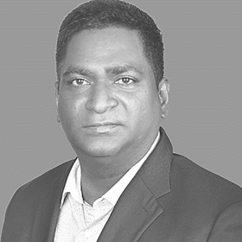
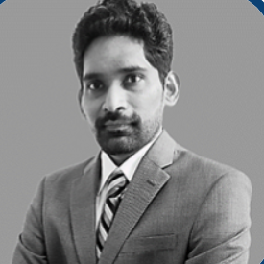
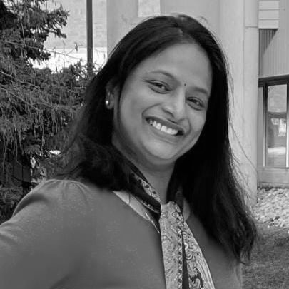
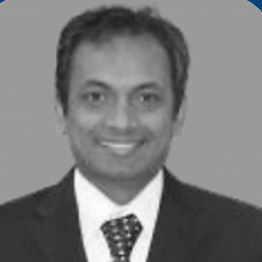



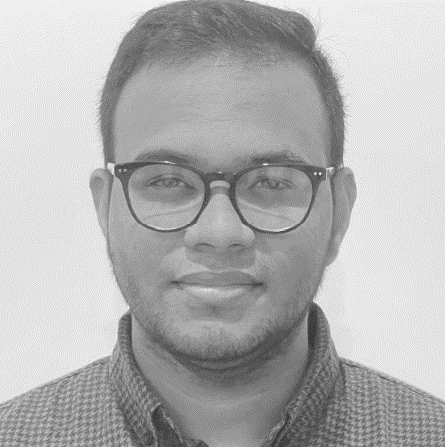
TEAM - SURGE TECHNOLOGIES
US & Canada
Gayathri Kalimuthu
Founder & Chairman
Prem Kumar
Munna Swamy
Founder & CEO
Vinay Kumar
Munna Swamy
COO/CFO
Vahini Balmoori
Lead Recruiter
Biplab Ray
Sr. Vice President
Tony DellaTorre
Sr. Vice President Sales
Krishna Subbaraj
Director Technology & Sales
Soumya Madishetty
Human Resources & Contracts
Saikiran Talasila
Lead Recruiter
12

Slide 13
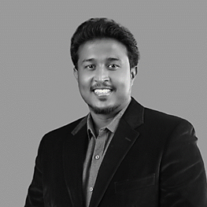

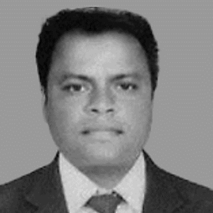
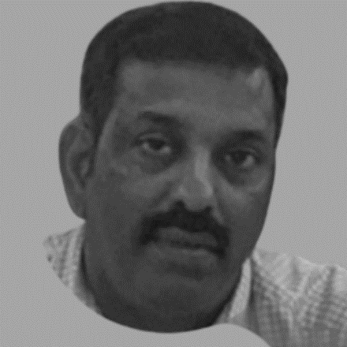
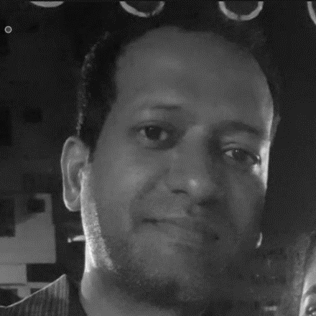
TEAM - SURGE TECHNOLOGIES
India
Jayaraja Kumaran
Delivery Manager
Garima Madan
Director Marketing
Muralibabu Muthukrishnan
Solution Architect
Sivakumar Shanmugam
Lead program manager
Sai Krishna Inampudi
HR Manager
13

Slide 14









Biplab_r@surgetechinc.com +1(614) 783 1203
Contact us
Tony_d@surgetechinc.com +1(770) 329 3607
vinaykumar_ms@surgetechinc.com +1(416) 450 6783
Biplab_r@surgetechinc.com
+1(614) 783 1203
jayaraja_k@surgetechinc.in +91 9150061306
Tony_d@surgetechinc.com
+1(770) 329 3607
vinaykumar_ms@surgetechinc.com
+1(416) 450 6783
Jayaraja_k@surgetechinc.in
+ 91 9150061306
Americas, Asia-Pacific, Europe | Middle East | Africa

